Slide 1






AI/ML in Sustainable Agriculture
Week
Plan Week
Set priorities and goals
Execute Tasks
Work through key actions
Review Progress
Assess outcomes and gaps
Adjust Next
Refine plans for following week
2 Submission: Advancing Crop Disease Detection through Computer Vision
This submission outlines the progress made in the second week of our project focusing on leveraging Artificial Intelligence and Machine Learning for early and accurate crop disease detection. Effective detection is crucial for mitigating yield losses, reducing pesticide use, and promoting more sustainable agricultural practices globally. Our work builds upon the foundational steps established in Week 1, moving towards the development and evaluation of a robust convolutional neural network model.

Slide 2
Recap of Week 1: Laying the Foundation
Problem Definition: Crop Disease Detection
Dataset: PlantVillage
Our chosen dataset, PlantVillage, is a widely recognized benchmark in agricultural computer vision. It comprises approximately 54,000 high-resolution images of healthy and diseased plant leaves, categorized into 38 distinct disease classes across 14 different plant species. This diverse and extensive dataset provides a solid foundation for training robust deep learning models capable of distinguishing subtle disease symptoms from healthy foliage.
In Week 1, we precisely defined the core challenge: the need for an automated, scalable, and accurate system for identifying plant diseases from visual imagery. Manual inspection is labor-intensive, often delayed, and requires specialized human expertise, leading to significant crop losses. Our AI/ML solution aims to provide timely insights, enabling targeted interventions and sustainable crop management. This directly addresses critical issues in food security and environmental protection.
Exploratory Data Analysis (EDA)
Project Timeline Across 4 Weeks
Our initial EDA focused on understanding the distribution of crops and disease categories within the PlantVillage dataset. This involved analyzing class imbalances, image resolutions, and potential variations in lighting or background. This preliminary analysis was crucial for informing our data preprocessing strategies and for anticipating potential challenges in model training, ensuring our approach accounts for the real-world variability of agricultural images.
A comprehensive 4-week project timeline was meticulously planned, allocating specific tasks and milestones for each week. Week 1 focused on problem framing and data acquisition; Week 2 on preprocessing and baseline model development; Week 3 on advanced model techniques and optimization; and Week 4 on final evaluation, reporting, and potential deployment considerations. This structured approach ensures systematic progress and efficient resource utilization.

Slide 3

Data Preprocessing: Preparing for Model Training
Effective data preprocessing is paramount for the success of any deep learning model, especially in image classification tasks. Our steps ensure that the data is clean, uniform, and augmented to enhance the model's generalization capabilities and prevent overfitting to specific image characteristics. These systematic transformations convert raw images into an optimal format for neural network consumption.
1
Image Resizing to 128x128 Pixels
All images from the PlantVillage dataset were uniformly resized to 128x128 pixels. This standardization reduces computational overhead during training, allowing for faster iterations and more efficient memory usage without significant loss of critical feature information at this resolution for leaf disease patterns. Resizing also ensures consistent input dimensions for the convolutional layers.
2
Normalization of Pixel Values (0-1)
Pixel values, originally in the range of 0-255, were normalized to a floating-point scale of 0 to 1. This normalization step is standard practice in neural network training as it helps stabilize the training process, preventing large input values from dominating the gradient calculations and allowing the model to converge more efficiently.
3
Train-Test Split (80%-20%)
The preprocessed dataset was divided into an 80% training set and a 20% testing set. This stratification ensures that the model is evaluated on unseen data, providing an unbiased estimate of its performance and generalization ability. The split was performed randomly but with consideration for class distribution to maintain balance.
Data augmentation is a critical strategy to improve the generalization of deep learning models, especially when working with finite datasets. By introducing slight variations to existing images, we simulate a broader range of real-world scenarios, making the model more robust to different perspectives, lighting conditions, and orientations of diseased leaves in the field.
4
Data Augmentation
To address potential overfitting and enhance the model's robustness to variations in real-world image capture, extensive data augmentation techniques were applied to the training set. This included random rotations (up to 20 degrees), zooming (up to 20%), and horizontal flips. These transformations artificially expand the training dataset, making the model more resilient to minor positional and orientation changes in new images.

Slide 4
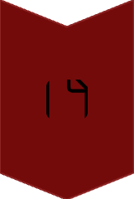




Baseline CNN Model Architecture: A Foundational Approach
Our initial approach involves a straightforward yet effective Convolutional Neural Network (CNN) architecture designed to establish a performance baseline for the crop disease detection task. This model comprises a series of convolutional layers followed by pooling operations to extract hierarchical features, culminating in dense layers for classification. This provides a solid foundation before exploring more complex or pre-trained models.
3 Convolutional Layers
The model begins with three sequential convolutional layers, progressively extracting features from the input images. Each layer uses 3x3 filters and ReLU activation functions, designed to learn increasingly complex patterns like edges, textures, and ultimately, specific disease lesion shapes. The early layers capture generic features, while deeper layers identify more abstract and localized patterns.
MaxPooling2D Layers
Following each convolutional layer, MaxPooling2D layers (2x2 pool size) are applied. These layers reduce the spatial dimensions of the feature maps, effectively downsampling the image representation. This not only decreases computational load but also helps make the model more robust to minor shifts and distortions in the input image by focusing on the most prominent features extracted by the convolutions.
Flatten + Dense Layers
After the final MaxPooling layer, the 2D feature maps are flattened into a 1D vector. This vector is then fed into two fully connected (Dense) layers. These layers are responsible for learning non-linear combinations of the extracted features and mapping them to the final disease categories. The first dense layer acts as a hidden layer, further refining the feature representation.
Dropout (0.5) for Regularization
A Dropout layer with a rate of 0.5 is strategically placed after the first dense layer. During training, this layer randomly sets half of the input units to zero at each update. This technique serves as a powerful regularization method, preventing complex co-adaptations between neurons and significantly reducing the risk of overfitting, thus improving the model's generalization performance on unseen data.
Output Layer & Optimization
The final dense layer has 38 units (corresponding to our disease classes) and uses a Softmax activation function to output class probabilities. The model is compiled with Categorical Crossentropy as the loss function, suitable for multi-class classification, and the Adam optimizer for efficient gradient descent optimization.
This architecture balances simplicity with sufficient capacity to learn from the image data, providing a robust starting point for our disease detection system. The sequential nature of convolutional and pooling layers allows for the hierarchical extraction of visual features, which are then used by the dense layers to make classification decisions.

Slide 5
Baseline Model Summary and Parameter Analysis
The following is a condensed summary of our baseline Convolutional Neural Network model's architecture, detailing each layer's type, output shape, and the number of trainable parameters. Understanding this summary is crucial for assessing model complexity and computational requirements.
Model: "sequential"_________________________________________________________________ Layer (type) Output Shape Param # ================================================================= conv2d (Conv2D) (None, 126, 126, 32) 896 max_pooling2d (MaxPooling2D) (None, 63, 63, 32) 0 conv2d_1 (Conv2D) (None, 61, 61, 64) 18496 max_pooling2d_1 (MaxPooling2D) (None, 30, 30, 64) 0 conv2d_2 (Conv2D) (None, 28, 28, 128) 73856 max_pooling2d_2 (MaxPooling2D) (None, 14, 14, 128) 0 flatten (Flatten) (None, 25088) 0 dense (Dense) (None, 128) 3211392 dropout (Dropout) (None, 128) 0 dense_1 (Dense) (None, 38) 4894 =================================================================Total params: 3,309,534Trainable params: 3,309,534Non-trainable params: 0_________________________________________________________________
This model has a total of 3,309,534 parameters, all of which are trainable. The majority of these parameters reside within the first Dense layer, which connects the flattened feature maps to the 128 hidden units. This high parameter count indicates a significant learning capacity, essential for capturing the intricate patterns of various plant diseases. The absence of non-trainable parameters confirms that no pre-trained weights were used in this baseline iteration. This summary confirms the computational load and structural depth of our chosen baseline model for Week 2.

Slide 6
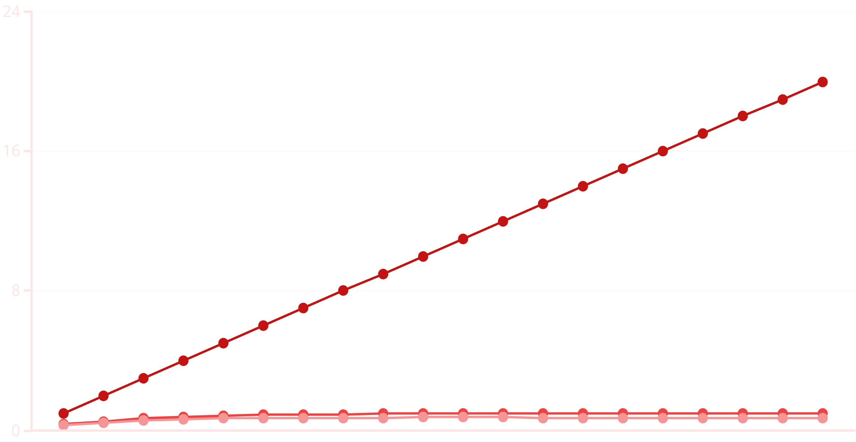
Training vs. Validation Accuracy: Performance Assessment
The chart below illustrates the accuracy performance of our baseline CNN model over 20 training epochs, comparing the accuracy on the training dataset against the accuracy on the validation (test) dataset. This visualization is key to understanding the model's learning trajectory and identifying potential issues like overfitting.
Epoch
Training Accuracy
Validation Accuracy
As observed, the training accuracy consistently increases and quickly approaches 1.0, indicating that the model is effectively learning to classify the training data. However, the validation accuracy plateaus around 0.75 after approximately 10-12 epochs and shows a slight decline thereafter. This divergence between training and validation accuracy is a clear indicator of overfitting. The model is becoming too specialized to the training examples and is losing its ability to generalize to unseen data. This observation highlights the need for further regularization techniques and/or more sophisticated model architectures in Week 3.

Slide 7
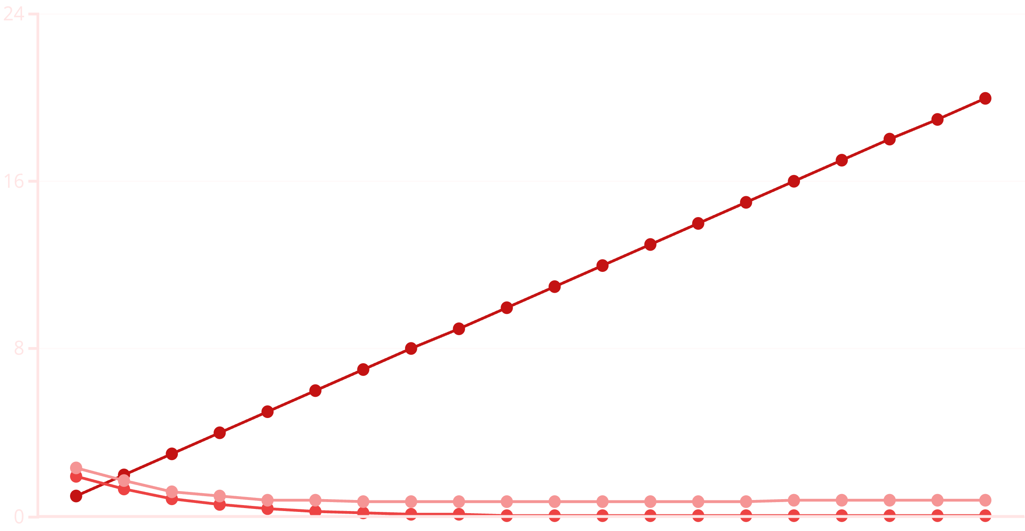
Training vs. Validation Loss: Optimization Insights
Complementing the accuracy metrics, the loss curves provide critical insights into the optimization process and the model's learning effectiveness. This chart displays the categorical crossentropy loss for both the training and validation datasets across the 20 epochs.
Epoch
Training Loss
Validation Loss
The training loss rapidly decreases and converges close to zero, indicating that the model is very effectively minimizing error on the data it has seen during training. However, the validation loss reaches its minimum around epoch 9-10 and subsequently begins to increase. This phenomenon is the hallmark of overfitting, where the model starts to learn noise or specific characteristics of the training data that do not generalize well to new, unseen examples. The increasing validation loss signals that the model's performance on real-world data would degrade if training continued past this optimal point. Future steps will focus on mitigating this trend.

Slide 8




Plan for Week 3: Enhancing Model Performance
Building on the insights from Week 2's baseline model, our strategy for Week 3 is squarely focused on significantly improving accuracy and addressing the observed overfitting. This will involve leveraging advanced deep learning techniques and systematic optimization.
Apply Transfer Learning with Pre-trained Models
Perform Hyperparameter Tuning
We will explore the use of pre-trained convolutional neural networks, such as ResNet (e.g., ResNet50 or ResNet101) or MobileNet, as feature extractors. These models, pre-trained on large datasets like ImageNet, have learned highly generalized image features that are often transferable to new domains. We plan to freeze their early layers and fine-tune only the later, task-specific layers, significantly accelerating convergence and improving performance with less data.
Systematic hyperparameter tuning will be conducted to optimize model performance. This includes experimenting with different learning rates, batch sizes, optimizer variations (e.g., Adam with different decay schedules), and varying the dropout rates. Techniques such as grid search or random search will be employed to efficiently explore the hyperparameter space and identify optimal configurations that minimize validation loss and maximize accuracy.
Evaluate with Confusion Matrix & Classification Report
Aim to Improve Accuracy and Reduce Overfitting
The overarching goal for Week 3 is to achieve a substantial improvement in validation accuracy and effectively mitigate the observed overfitting. By combining transfer learning with refined hyperparameters and careful evaluation, we anticipate developing a more robust and generalized model capable of highly accurate and reliable crop disease detection in diverse agricultural settings. This improvement is vital for practical deployment.
Beyond accuracy, a comprehensive evaluation will involve generating a confusion matrix and a detailed classification report. These tools provide granular insights into per-class performance, including precision, recall, and F1-score for each of the 38 disease classes. This will help identify specific classes where the model struggles and guide further architectural or data-related improvements.

